Slide 1

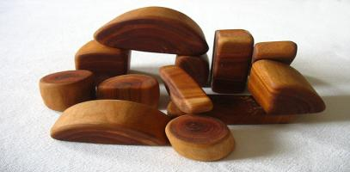
Object-Oriented Programming Fundamental Principles – Part II
Svetlin Nakov
Telerik Corporation
www.telerik.com
Notes:
(c) 2006 National Academy for Software Development - http://academy.devbg.org*
1##

Slide 2

Contents
Polymorphism
Class Hierarchies: Real World Example
Cohesion and Coupling

Slide 3
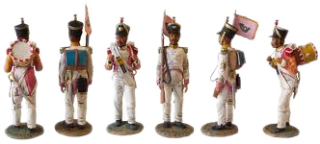
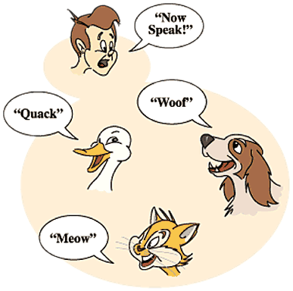
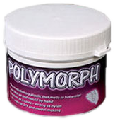
Polymorphism
Notes:
(c) 2006 National Academy for Software Development - http://academy.devbg.org*
3##

Slide 4
Polymorphism
Polymorphism = ability to take more than one form (objects have more than one type)
A class can be used through its parent interface
A child class may override some of the behaviors of the parent class
Polymorphism allows abstract operations to be defined and used
Abstract operations are defined in the base class' interface and implemented in the child classes
Declared as abstract or virtual
4

Slide 5
Polymorphism (2)
Why handle an object of given type as object of its base type?
To invoke abstract operations
To mix different related types in the same collection
E.g. List<object> can hold anything
To pass more specific object to a method that expects a parameter of a more generic type
To declare a more generic field which will be initialized and "specialized" later
5

Slide 6
Virtual Methods
Virtual method is method that can be used in the same way on instances of base and derived classes but its implementation is different
A method is said to be a virtual when it is declared as virtual
Methods that are declared as virtual in a base class can be overridden using the keyword override in the derived class
public virtual void CalculateSurface()

Slide 7
The override Modifier
Using override we can modify a method or property
An override method provides a new implementation of a member inherited from a base class
You cannot override a non-virtual or static method
The overridden base method must be virtual, abstract, or override

Slide 8
Polymorphism – How it Works?
Polymorphism ensures that the appropriate method of the subclass is called through its base class' interface
Polymorphism is implemented using a technique called late method binding
Exact method to be called is determined at runtime, just before performing the call
Applied for all abstract / virtual methods
Note: Late binding is slower than normal (early) binding
8

Slide 9
Polymorphism – Example
Abstract class
Figure
Abstract action
+CalcSurface() : double
Concrete class
Square
Circle
-x : int
-y : int
-size : int
-x : int
-y : int
-radius: int
Overriden action
Overriden action
override … CalcSurface()
{
return size * size;
}
override double CalcSurface()
{
return PI * radius * raduis;
}
9

Slide 10
Polymorphism – Example (2)
abstract class Figure
{
public abstract double CalcSurface();
}
abstract class Square
{
public override double CalcSurface() { return … }
}
Figure f1 = new Square(...);
Figure f2 = new Circle(...);
// This will call Square.CalcSurface()
int surface = f1.CalcSurface();
// This will call Square.CalcSurface()
int surface = f2.CalcSurface();

Slide 11
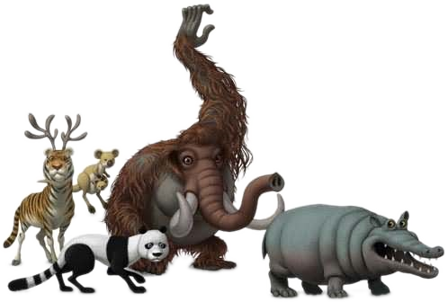
Polymorphism
Live Demo
Notes:
(c) 2006 National Academy for Software Development - http://academy.devbg.org*
11##

Slide 12
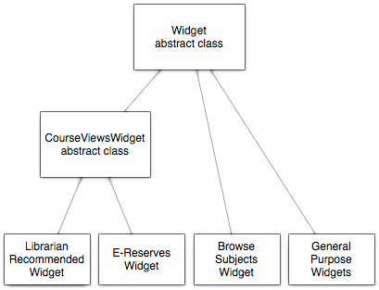
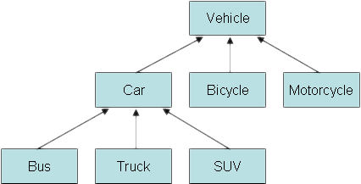
Class Hierarchies: Real World Example
Notes:
(c) 2006 National Academy for Software Development - http://academy.devbg.org*
12##

Slide 13
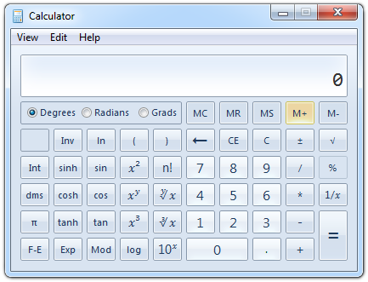
Real World Example: Calculator
Creating an application like the Windows Calculator
Typical scenario for applying the object-oriented approach
13

Slide 14
Real World Example: Calculator (2)
The calculator consists of controls:
Buttons, panels, text boxes, menus, check boxes, radio buttons, etc.
Class Control – the root of our OO hierarchy
All controls can be painted on the screen
Should implement an interface IPaintable with a method Paint()
Common properties: location, size, text, face color, font, background color, etc.
14

Slide 15
Real World Example: Calculator (3)
Some controls could contain other (nested) controls inside (e. g. panels and toolbars)
We should have class Container that extends Control holding a collection of child controls
The Calculator itself is a Form
Form is a special kind of Container
Contains also border, title (text derived from Control), icon and system buttons
How the Calculator paints itself?
Invokes Paint() for all child controls inside it
15

Slide 16
Real World Example: Calculator (4)
How a Container paints itself?
Invokes Paint() for all controls inside it
Each control knows how to visualize itself
What is the common between buttons, check boxes and radio buttons?
Can be pressed
Can be selected
We can define class AbstractButton and all buttons can derive from it
16

Slide 17
Calculator Classes
«interface»
IPaintable
Paint()
Control
-location
-size
-text
-bgColor
-faceColor
-font
Container
AbstractButton
TextBox
MainMenu
MenuItem
Panel
Form
Button
CheckBox
RadioButton
Calculator
17

Slide 18

Cohesion and Coupling

Slide 19
Cohesion
Cohesion describes how closely all the routines in a class or all the code in a routine support a central purpose
Cohesion must be strong
Well-defined abstractions keep cohesion strong
Classes must contain strongly related functionality and aim for single purpose
Cohesion is a useful tool for managing complexity

Slide 20
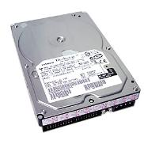
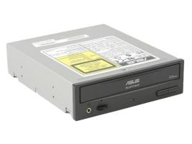
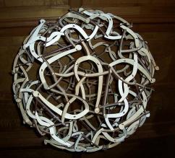
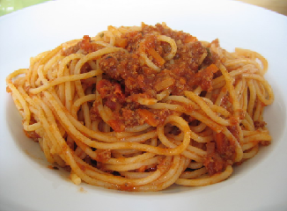
Good and Bad Cohesion
Good: hard disk, cdrom, floppy
BAD: spaghetti code

Slide 21
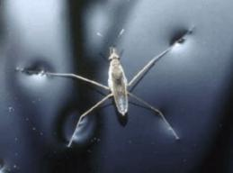
Strong Cohesion
Strong cohesion example
Class Math that has methods:
Sin(), Cos(), Asin()
Sqrt(), Pow(), Exp()
Math.PI, Math.E
double sideA = 40, sideB = 69;
double angleAB = Math.PI / 3;
double sideC =
Math.Pow(sideA, 2) + Math.Pow(sideB, 2)
- 2 * sideA * sideB * Math.Cos(angleAB);
double sidesSqrtSum = Math.Sqrt(sideA) + Math.Sqrt(sideB) + Math.Sqrt(sideC);

Slide 22
Bad Cohesion
Bad cohesion example
Class Magic that has these methods:
Another example:
public void PrintDocument(Document d);
public void SendEmail(
string recipient, string subject, string text);
public void CalculateDistanceBetweenPoints(
int x1, int y1, int x2, int y2)
MagicClass.MakePizza("Fat Pepperoni");
MagicClass.WithdrawMoney("999e6");
MagicClass.OpenDBConnection();

Slide 23
Coupling
Coupling describes how tightly a class or routine is related to other classes or routines
Coupling must be kept loose
Modules must depend little on each other
All classes and routines must have small, direct, visible, and flexible relations to other classes and routines
One module must be easily used by other modules

Slide 24
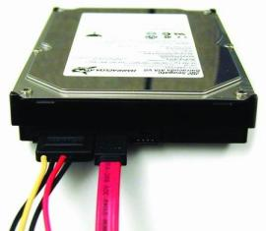
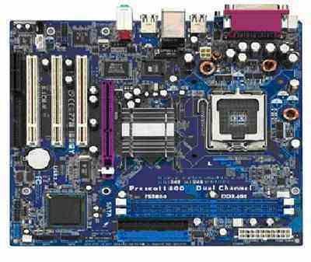
Loose and Tight Coupling
Loose Coupling:
Easily replace old HDD
Easily place this HDD to another motherboard
Tight Coupling:
Where is the video adapter?
Can you change the video controller?

Slide 25
Loose Coupling – Example
class Report
{
public bool LoadFromFile(string fileName) {…}
public bool SaveToFile(string fileName) {…}
}
class Printer
{
public static int Print(Report report) {…}
}
class Program
{
static void Main()
{
Report myReport = new Report();
myReport.LoadFromFile("C:\\DailyReport.rep");
Printer.Print(myReport);
}
}

Slide 26
Tight Coupling – Example
class MathParams
{
public static double operand;
public static double result;
}
class MathUtil
{
public static void Sqrt()
{
MathParams.result = CalcSqrt(MathParams.operand);
}
}
class MainClass
{
static void Main()
{
MathParams.operand = 64;
MathUtil.Sqrt();
Console.WriteLine(MathParams.result);
}
}

Slide 27
Spaghetti Code
Combination of bad cohesion and tight coupling:
class Report
{
public void Print() {…}
public void InitPrinter() {…}
public void LoadPrinterDriver(string fileName) {…}
public bool SaveReport(string fileName) {…}
public void SetPrinter(string printer) {…}
}
class Printer
{
public void SetFileName() {…}
public static bool LoadReport() {…}
public static bool CheckReport() {…}
}

Slide 28
Summary
OOP fundamental principals are: inheritance, encapsulation, abstraction, polymorphism
Inheritance allows inheriting members from another class
Abstraction and encapsulation hide internal data and allow working through abstract interface
Polymorphism allows working with objects through their parent interface and invoke abstract actions
Strong cohesion and loose coupling avoid spaghetti code

Slide 29


Object-Oriented Programming Fundamental Principles – Part II
Questions?
http://academy.telerik.com

Slide 30
Exercises
Define abstract class Shape with only one abstract method CalculateSurface() and fields width and height. Define two new classes Triangle and Rectangle that implement the virtual method and return the surface of the figure (height*width for rectangle and height*width/2 for triangle). Define class Circle and suitable constructor so that on initialization height must be kept equal to width and implement the CalculateSurface() method. Write a program that tests the behavior of the CalculateSurface() method for different shapes (Circle, Rectangle, Triangle) stored in an array.
30

Slide 31
Exercises (1)
A bank holds different types of accounts for its customers: deposit accounts, loan accounts and mortgage accounts. Customers could be individuals or companies.
All accounts have customer, balance and interest rate (monthly based). Deposit accounts are allowed to deposit and with draw money. Loan and mortgage accounts can only deposit money.
All accounts can calculate their interest amount for a given period (in months). In the common case its is calculated as follows: number_of_months * interest_rate.

Slide 32
Exercises (2)
Loan accounts have no interest for the first 3 months if are held by individuals and for the first 2 months if are held by a company.
Deposit accounts have no interest if their balance is positive and less than 1000.
Mortgage accounts have ½ interest for the first 12 months for companies and no interest for the first 6 months for individuals.
Your task is to write a program to model the bank system by classes and interfaces. You should identify the classes, interfaces, base classes and abstract actions and implement the calculation of the interest functionality.

